Slide 1
MASTODON-AD: Planning a Platform Trial for Symptomatic Alzheimer’s Disease
Celebrating Scottish Research Conference 2024
Paresh Malhotra

Slide 2
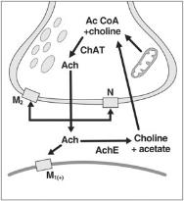
Treatment options in clinical AD AChE Inhibitors: Donepezil, Rivastigmine, Galantamine Memantine (NMDA Receptor Antagonist)

Slide 3
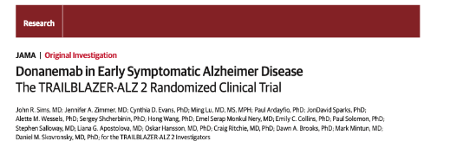
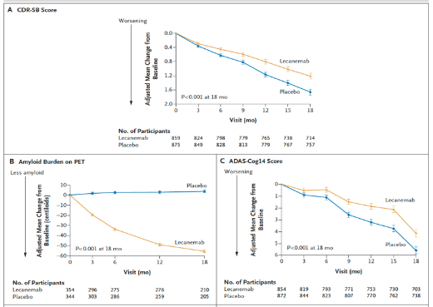
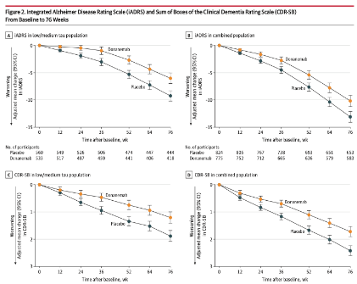
Recent developments

Slide 4
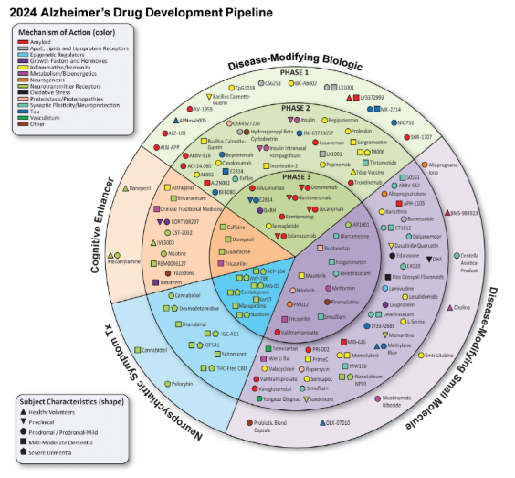
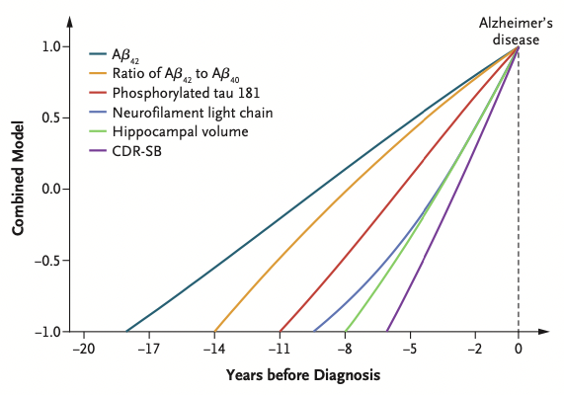
On the horizon

Slide 5
On the horizon

Slide 6
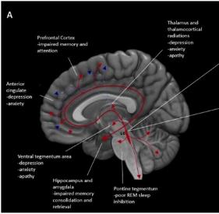
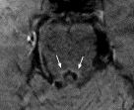
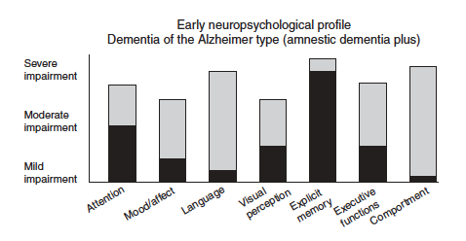
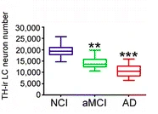
One approach
Evaluating the efficacy of extended-release guanfacine as an add-on therapy in AD.
Does combined Cholinergic/noradrenergic stimulation boost attention in AD?
Malhotra, Curr Op in Psychol 2018
Holland, Robbins and Rowe, Brain 2021
Weintraub et al, 2012 Cold Spring Harb Perspect Med
Kelly et al. Acta Neuropathologica Communications 2017

Slide 7
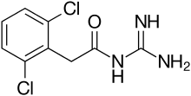
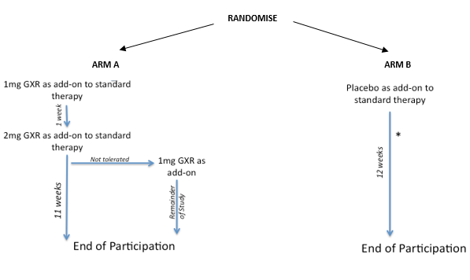
One approach
TREATMENT - Double-blind add-on trial with Extended Release Guanfacine Duration - 12 weeks Treatment (Final Follow-up Phone-call at 13 Weeks)
NorAD

Slide 8
NorAD
DESIGN - Double-blind, Randomised Placebo-controlled Trial
AIMS – Guanfacine vs placebo, in co-administration with standard cholinesterase treatment, 12 weeks of treatment in mild-moderate AD.
OUTCOME MEASURES - Primary Outcome Measure: ADAS-Cog
SECONDARY MEASURES - Trails A and B; Digit-symbol substitution, Test of Everyday Attention (Map search and Elevator Counting with distraction), CANTAB-RVP, Caregiver Burden (Zarit Burden), Neuropsychiatric Inventory, Activities of Daily Living Inventory, Epworth sleepiness scale
POPULATION - 160 outpatients mild-moderate AD and on cholinesterase inhibitors (Donepezil, Rivastigmine, Galantamine).
ELIGIBILITY – MMSE Score 10-30

Slide 9
Outcome Measures

Slide 10
‘Learnings’

Slide 11
Learnings
Setup for single trials is inefficient
Outdated outcome measures
Overinvestment in individual therapies

Slide 12
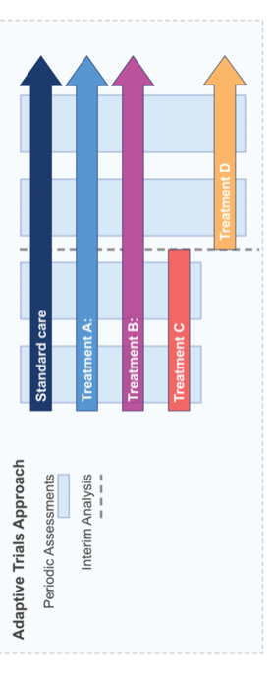
The Platform Trial Solution

Slide 13
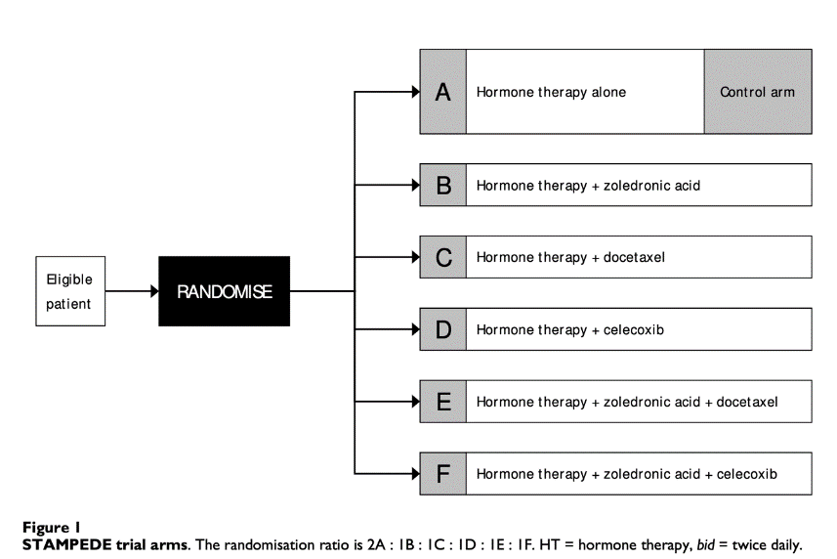
STAMPEDE

Slide 14
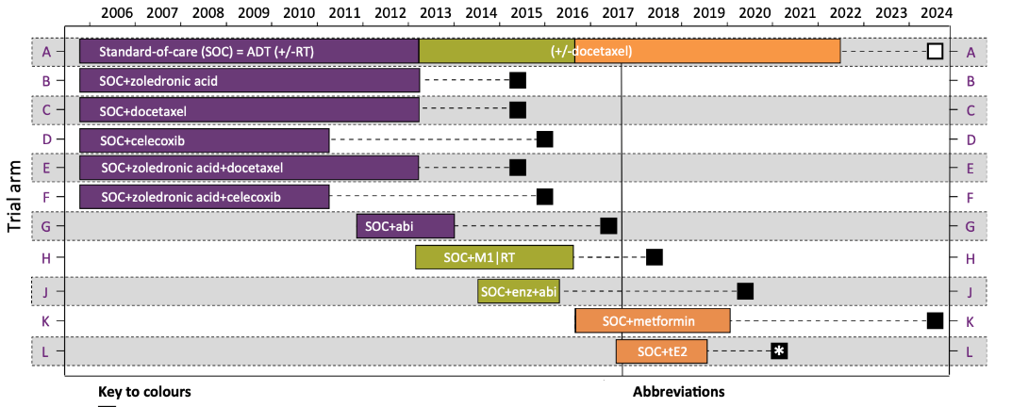
STAMPEDE

Slide 15
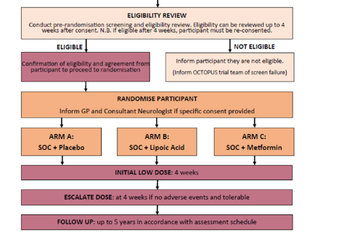
Parker et al, Trials 2023
OCTOPUS, ISRCTN140448364
Notes:
DESIGN - Double-blind, Randomised Placebo-controlled Trial
AIMS – Guanfacine vs placebo, in co-administration with standard cholinesterase treatment, 12 weeks of treatment in mild-moderate AD.
OUTCOME MEASURES - Primary Outcome Measure: ADAS-Cog
SECONDARY MEASURES - Trails A and B; Digit-symbol substitution, Test of Everyday Attention (Map search and Elevator Counting with distraction), CANTAB-RVP, Caregiver Burden (Zarit Burden), Neuropsychiatric Inventory, Activities of Daily Living Inventory, Epworth sleepiness scale
POPULATION - 160 outpatients mild-moderate AD and on cholinesterase inhibitors (Donepezil, Rivastigmine, Galantamine).
ELIGIBILITY – MMSE Score 10-30

Slide 16
ACORD A Collaboration of Groups Developing, Running and Reporting Multi-Arm Multi-Stage (MAMS) Platform Trials in Neurodegenerative diseases

Slide 17
ACORD + Dementias Platform UK
A Multi-Arm, multi-Stage Trial platfOrm for Dementia and mild cOgNitive impairment due to Alzheimer's Disease (MASTODON-AD)
Repurposing in first phase
Clinical diagnosis of AD, MMSE>17
Looking for sustained clinical response (18m)
ADAS-Cog, NPI, Bristol ADL
Using MRI and blood biomarkers as novel secondary measures
Incorporate novel outcome measures

Slide 18
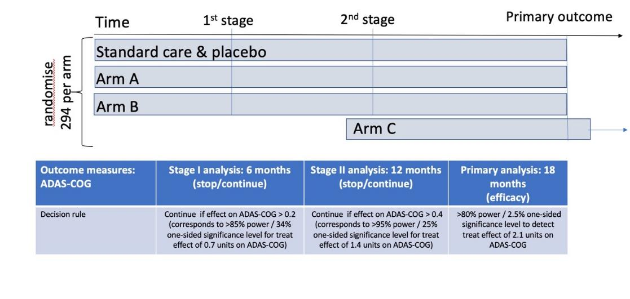
MASTODON-AD
Notes:
DESIGN - Double-blind, Randomised Placebo-controlled Trial
AIMS – Guanfacine vs placebo, in co-administration with standard cholinesterase treatment, 12 weeks of treatment in mild-moderate AD.
OUTCOME MEASURES - Primary Outcome Measure: ADAS-Cog
SECONDARY MEASURES - Trails A and B; Digit-symbol substitution, Test of Everyday Attention (Map search and Elevator Counting with distraction), CANTAB-RVP, Caregiver Burden (Zarit Burden), Neuropsychiatric Inventory, Activities of Daily Living Inventory, Epworth sleepiness scale
POPULATION - 160 outpatients mild-moderate AD and on cholinesterase inhibitors (Donepezil, Rivastigmine, Galantamine).
ELIGIBILITY – MMSE Score 10-30

Slide 19
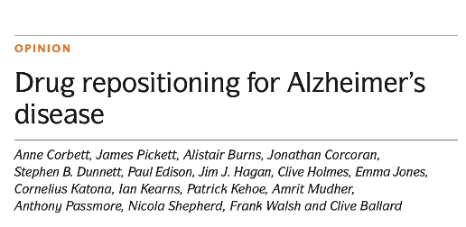
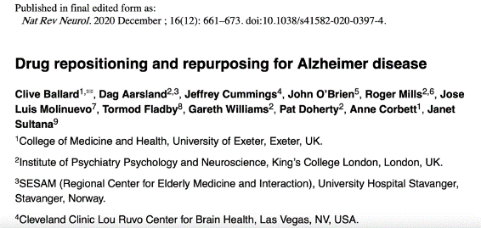
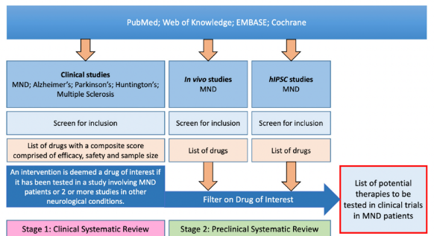
MASTODON-AD
Notes:
DESIGN - Double-blind, Randomised Placebo-controlled Trial
AIMS – Guanfacine vs placebo, in co-administration with standard cholinesterase treatment, 12 weeks of treatment in mild-moderate AD.
OUTCOME MEASURES - Primary Outcome Measure: ADAS-Cog
SECONDARY MEASURES - Trails A and B; Digit-symbol substitution, Test of Everyday Attention (Map search and Elevator Counting with distraction), CANTAB-RVP, Caregiver Burden (Zarit Burden), Neuropsychiatric Inventory, Activities of Daily Living Inventory, Epworth sleepiness scale
POPULATION - 160 outpatients mild-moderate AD and on cholinesterase inhibitors (Donepezil, Rivastigmine, Galantamine).
ELIGIBILITY – MMSE Score 10-30

Slide 20
PRE-MASTODON-AD
Trial design finalisation
Interventions
Outcome Measures (inc Digital)
Notes:
Moving target

Slide 21
Drug Prioritisation
Invitation for Proposals
https://www.mrcctu.ucl.ac.uk/studies/all-studies/p/pre-mastodon-ad/
Panellists inc. Gordon Wilcock, Lon Schneider, John O’Brien, Alastair Reith, Eric Karran, Jeff Cummings, Rik Vandenberghe, John O’Brien, Geri Barrett, Fiona Ducotterd
Process supported by Macleod group
Notes:
Moving target

Slide 22
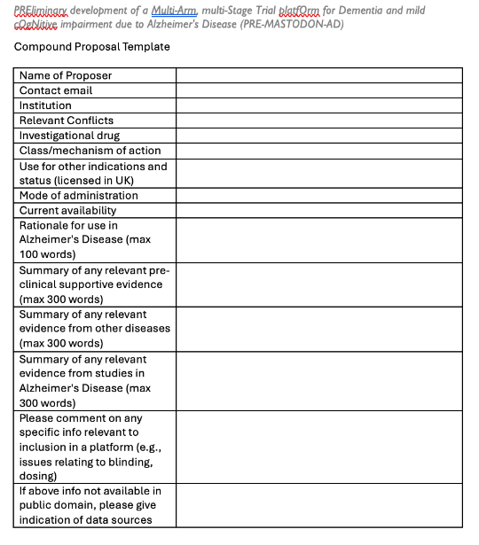
Drug Prioritisation
https://www.mrcctu.ucl.ac.uk/studies/all-studies/p/pre-mastodon-ad/
Notes:
Moving target

Slide 23
Outcome Measures
Acceptability to participants (burden of assessment) and PPI/E groups:
Inclusivity
Assessment burden
Health Related Quality of Life
Progression
Notes:
Moving target

Slide 24
PPIE
Across all areas of the trial
Drug selection
Outcome selection
Methodology
Public Involvement Impact Assessment Framework (PIIAF)
Notes:
Moving target

Slide 25
PRE-MASTODON-AD
Symptom versus Disease Modification
Feasibility for a Platform versus Efficacy
Clinical introduction of Anti-Amyloid Abs
Notes:
Moving target

Slide 26
Questions and Discussion
Notes:
Moving target

